Slide 1
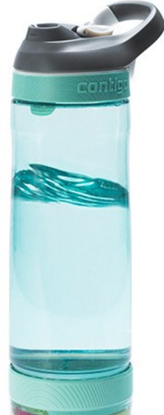
Do you drink enough water ? Smart Water Bottle is the solution
Presented by:
Bader Albulayhis

Slide 2
Goal, Benefits and Why ?
Encouragement and motivation.
Stay hydrated
Why did I build this project?
Friends feedback..

Slide 3
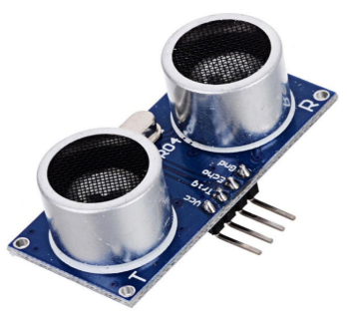
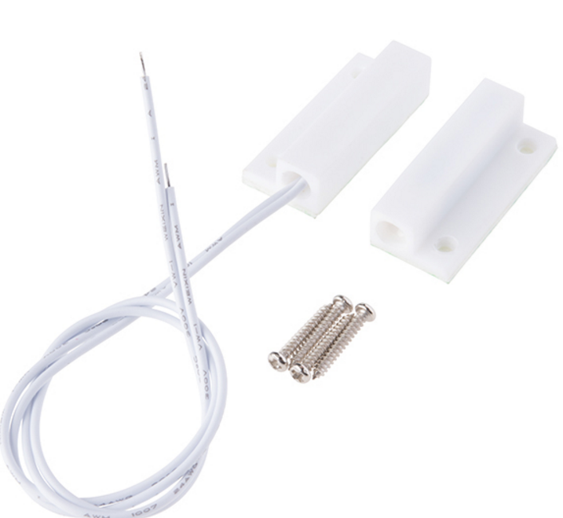
Sensors type
Ultrasonic Sensor
Magnetic Door Switch

Slide 4

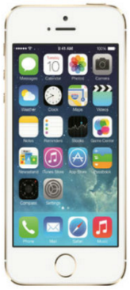
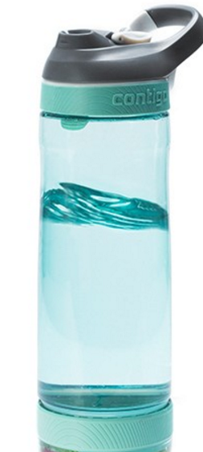




Architecture design

Slide 5
Demo . .

Slide 6
Other services
End of day services
1- Clean()
2- Update the history
Reminder service
Status Monitor

Slide 7
Major issue
1- How do I know if you are drinking the water or dumping the water ?

Slide 8
Lessons learned
From What’s IOT ? tell building a product.

Slide 9
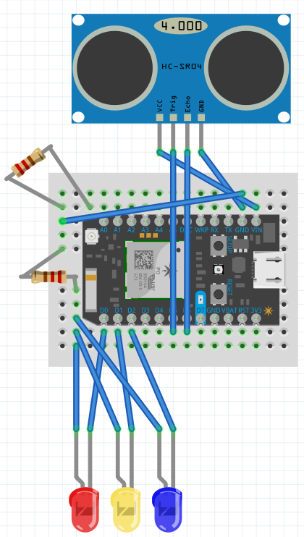
Fritzing

Slide 10
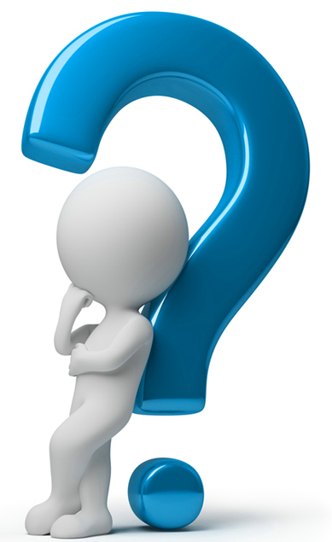
Questions?

